Slide 1

Environmental Impacts of Food Production
By Andrew Kojo Mensah-Onumah

Slide 2
Overview
Rising global temperatures and its attendant consequences is mainly due to man-made activities.
Large-scale food production is a contribution factor.
Understand the impacts caused by the production of different food products.
Discuss potential solutions.

Slide 3
Measuring Environmental Impact
Key Metric Groups
GHG Emissions
Water use
Land use
Nutrient pollution
Notes:
GHG Emissions - GHG Emissions per kcal, transportation, processing, packaging
Water use - Freshwater withdrawals and scarcity-use per kcal of food product
Land use - Land use per kcal
Nutrient pollution - eutrophying emissions per kcal (washing away of synthetic nutrients into water bodies).

Slide 4
Food Groups
Vegetables
Fruits
Legumes
Oils
Meat
Animal products
Carbohydrates
Beverages
Sugars
Seafood
Individual food products have been segregated

Slide 5
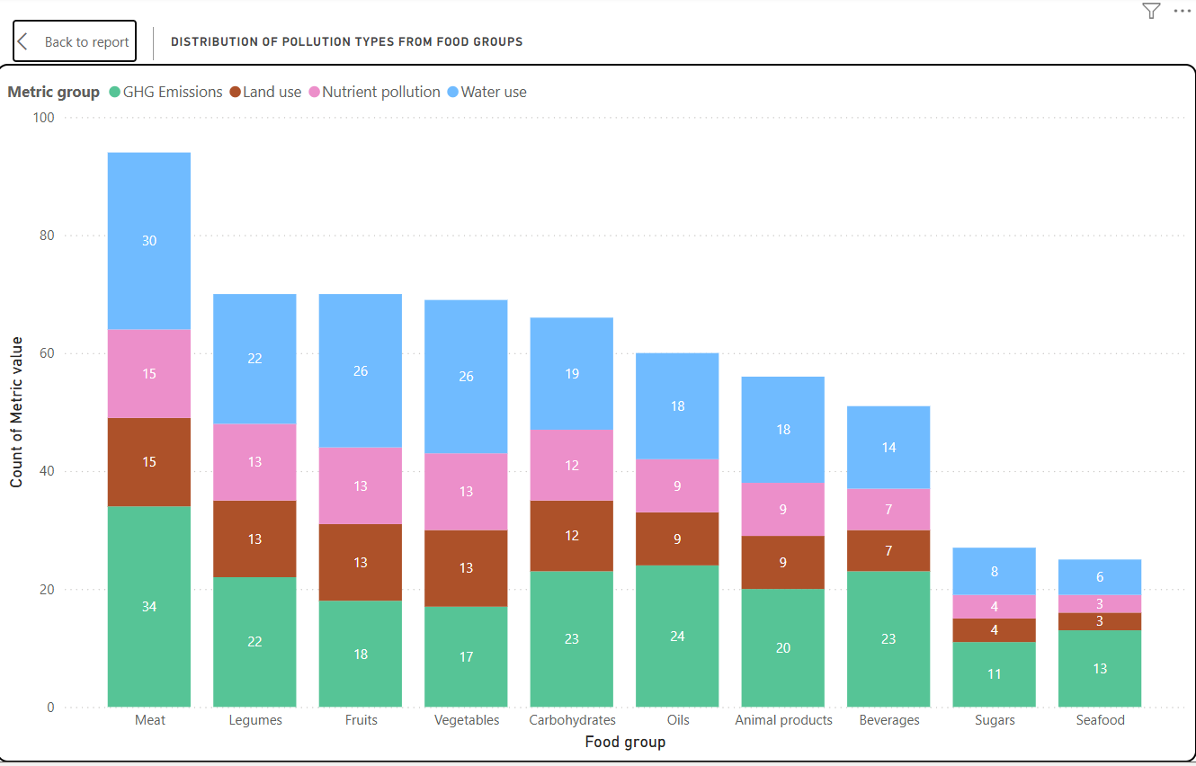

Slide 6
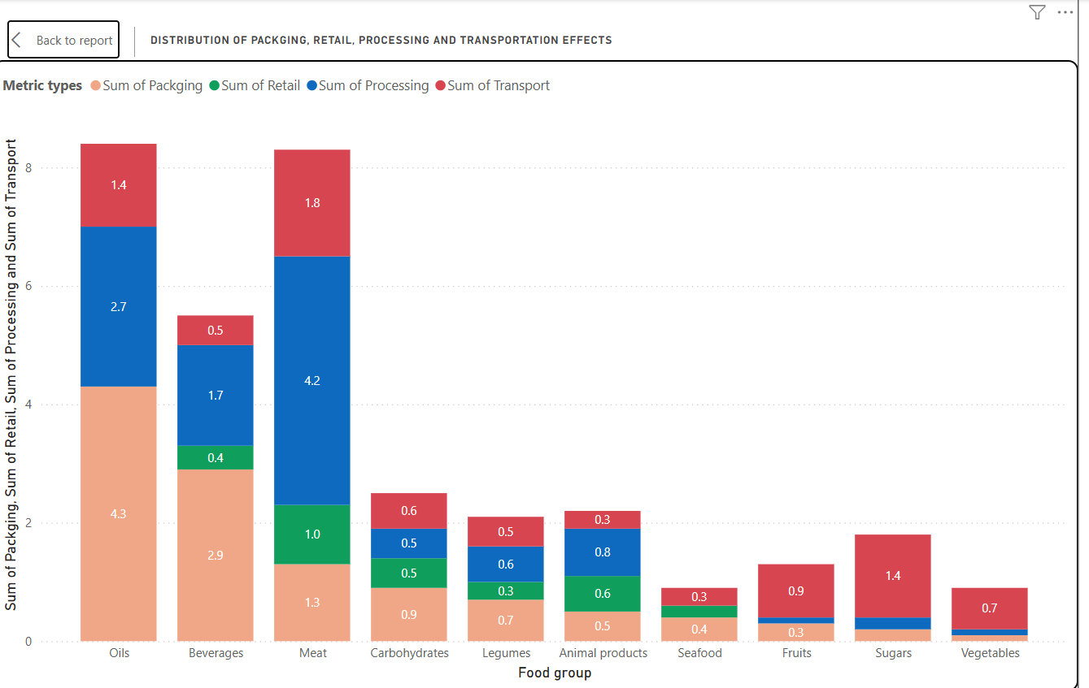

Slide 7
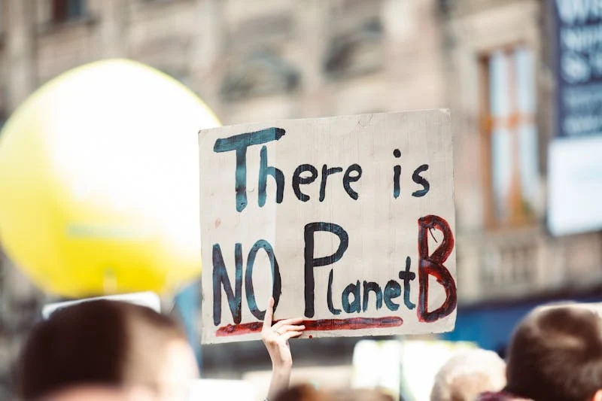

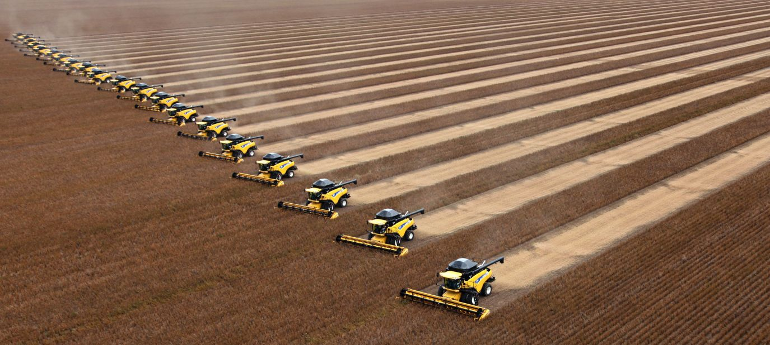
Aha! My discoveries
What did you learn from the analysis?
Different food groups have different emission issues. A one-stop-all solution is not possible to reduce the environmental impact caused by large-scale food production.
More sustainable farming practices and intentional lifestyle changes have to be made ie. reducing dependence on fast food chains to growing more local foods.

Slide 8
Conclusion
Large-scale food production contributes a significant amount to environmental degradation. From farm-lands being over exploited, to water bodies being washed with nutrients, to methane gas being emitted by livestock.
Modern solutions are needed for the various food groups to help minimise the impact effects. Lifestyle changes will be important to drive these changes.

